Slide 1



Bitcoin Price Prediction Using Machine Learning in Python
Utilizing AI to Forecast Cryptocurrency Markets

Slide 2



INTRODUCTION
Bitcoin: The first decentralized digital currency, known for its significant price volatility.
Objective: Leverage machine learning to predict Bitcoin prices, assisting traders and researchers in making informed decisions.

Slide 3
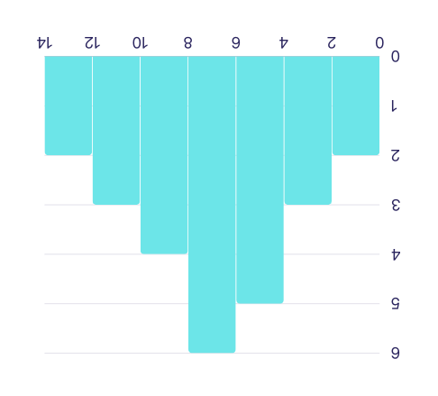

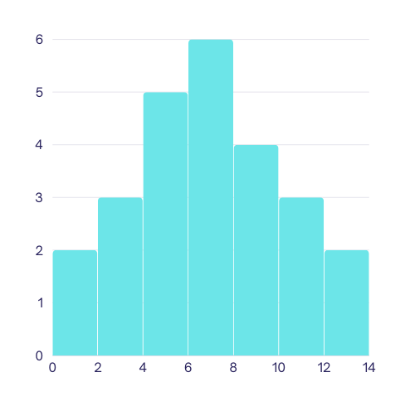
DATA COLLECTION
Historical Price Data: Includes open, high, low, close prices, volume, and timestamps.
Data Sources: APIs from CoinGecko, CoinMarketCap, or exchanges like Binance.
data source: google,CoinGecko API.

Slide 4


Sources
COIN GECKO
CHATGPT
KAGGLE
GIT HUB

Slide 5
DATA PREPROCESSING
Data Cleaning: Handle missing values, outliers, and duplicates.
Feature Engineering: Create new features like moving averages, RSI (Relative Strength Index), MACD (Moving Average Convergence Divergence), etc.
Normalization/Scaling: Normalize or scale the data to ensure all features contribute equally to the model.

Slide 6
MACHINE LEARNING MODELS
Linear Regression: A simple model that assumes a linear relationship between the input features and the Bitcoin price.
Support Vector Machines (SVM): Useful for regression tasks where the relationship is not strictly linear.
Random Forest: An ensemble method that builds multiple decision trees and averages the results.
Long Short-Term Memory (LSTM): A type of recurrent neural network (RNN) well-suited for time series prediction. It can capture temporal dependencies and is often used for predicting stock prices and cryptocurrencies.
ARIMA (AutoRegressive Integrated Moving Average): A classical time series forecasting method that can be used as a baseline model.

Slide 7

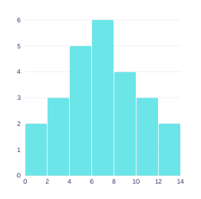

Advantages by using M.L for B.P
Machine learning models can identify and leverage complex patterns and correlations in historical data that might be missed by human analysts
l
Machine learning models can process vast amounts of data quickly, making them more efficient than traditional statistical methods.
PATTERN RECOGNITION:
EFFICIENCY
Machine learning models can adapt to new data and changing market dynamics, improving their accuracy over time.
ADAPTABILITY

Slide 8

Disadvantages
Machine learning models heavily depend on the quality and quantity of data. Poor-quality data can lead to inaccurate predictions
Machine learning models, especially deep learning models, can be complex and difficult to interpret, making it hard to understand the decision-making process.
COMPLEXITY
DATA DEPENDENCY
Bitcoin's price is highly volatile and influenced by factors that are difficult to quantify, such as market sentiment, regulatory changes, and macroeconomic events.
MARKET VOLATILITY

Slide 9




Preventions
Clean and preprocess the data meticulously, handle missing values, and use feature engineering to create more informative features.
Use simpler models when possible and apply model explainability techniques (e.g., SHAP values, LIME) to interpret complex models.
DATA DEPENDENCY
COMPLEXITY
Incorporate external data (e.g., news sentiment, macroeconomic indicators) into the model and use ensemble methods to combine predictions from different models to increase robustness.
MARKET VOLATILITY

Slide 10
